Slide 1
Introduction
Installing a Virtual Network

Slide 2
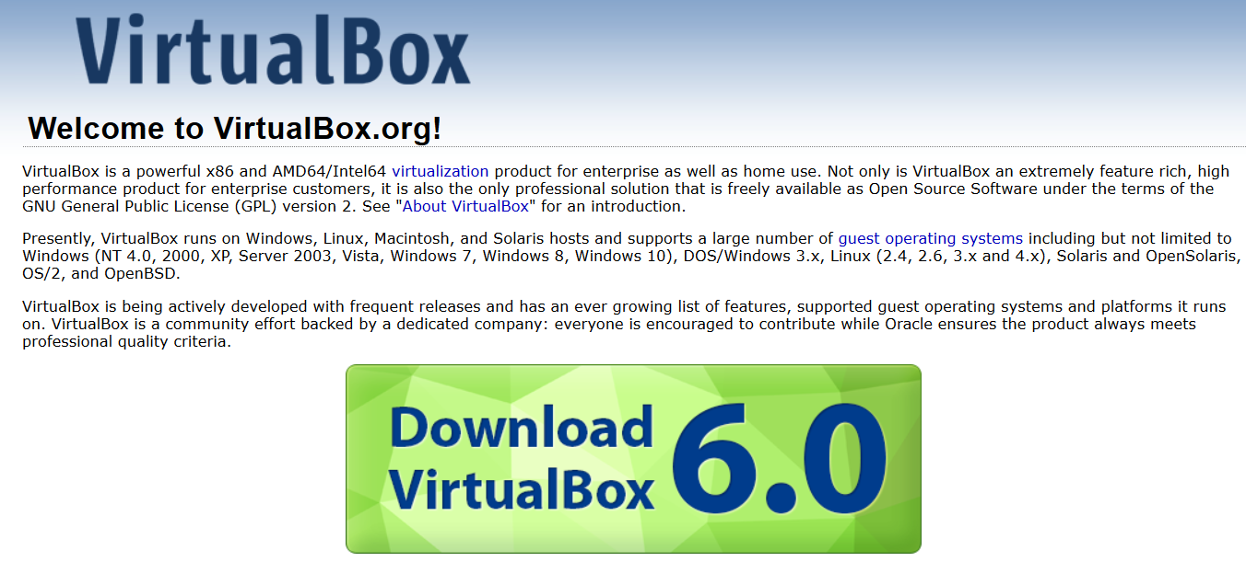

Slide 3
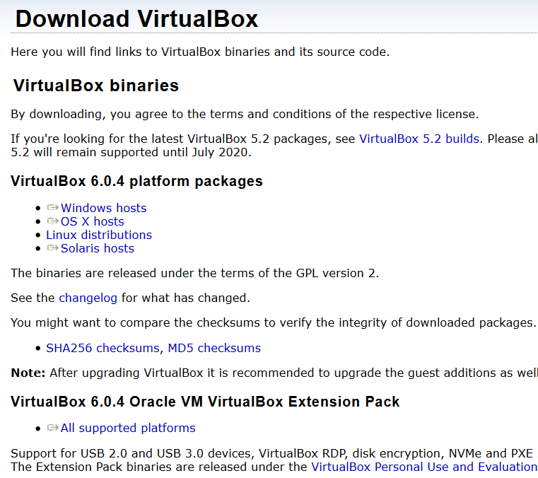
The extension pack must be for the exact same VirtualBox version

Slide 4
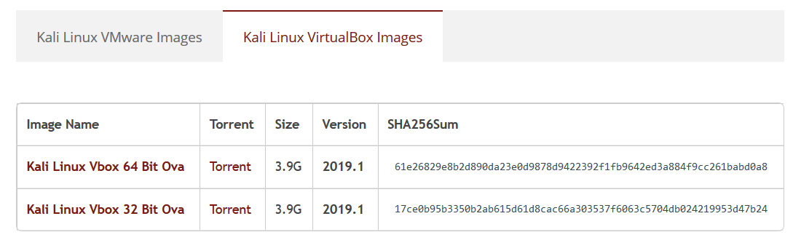
Download Kali from its official website, or the complete VM image from:
www.offensive-security.com/kali-linux-vmware-virtualbox-image-download/

Slide 5
Create a NAT Network in VirtualBox preferences
Select “NAT Network” in Network option of the VM
NOTE: NAT is not the same as NAT Network
The router will be the Host machine, and the VMs will connect to it

Slide 6



HOST
VMs
…
…
…

Slide 7
Introduction
Basic Linux Commands

Slide 8
Parameter example:
-a or --all one dash for letter, two for full word
Few Terminal commands:
pwd shows current directory
cd changes directory
man ls shows manual for ls
clear clears the terminal screen
ifconfig checks all the devices connected to the machine
Apt-get is the “program to install other programs”
apt-get update update all the programs in the OS, Debian like
apt-get install program_name install program_name
Notes:
Debian windows:
Ctrl+L in a window to see the actual path
Ctrl+Up or Down, changes the desktop (workspace)

Slide 9
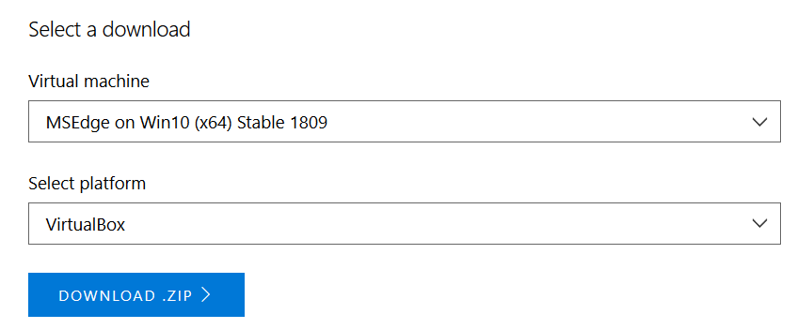
We'll assume that a Windows10 VM is installed in VirtualBox
This will be the target
Free VM can be downloaded from:
http://developer.microsoft.com/en-us/microsoft-edge/tools/vms
Password to access the OS: PasswOrd!
Notes:
It’s a zero…

Slide 10
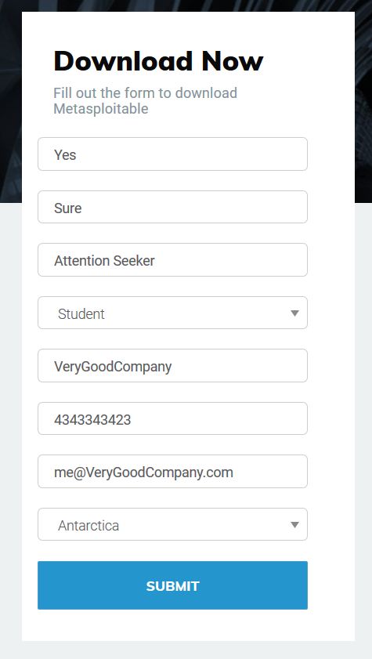
For testing you may want to install a “broken server” VM.
You can download Metasploitable VM from here:
https://information.rapid7.com/download-metasploitable-2017.html
You need company information, so fake email must be name@whatever.com, where whatever is the name of the company.

Slide 11
Then, create a VM in VirtualBox, Linux based, called Metaspoitable (1GB Ram)
Also, connect it to the virtual NAT Network
Use existing Drive, using the Metasploitable file downloaded (.vmdk)
User: msfadmin
Pass: msfadmin
It only has a terminal interface.
NOTE: never expose this machine to actual internet! Because is made to be hackable!!
Notes:
To poweroff:
'sudo poweroff'

Slide 12
We can attack machines with a real IP, so servers.
Your machine has the IP changed by the router
Basically, an internal IP, while on the internet you use the IP of the router
In general, though, if you can PING a device, you can attack it…

